Slide 1
Project Presentation of CO-OP Project at Industry (Module-2) (22CS421)
On
CareerAI – AI-Based Career Guidance System
Kshitij Raj Shukla 2210990526
Mayank Bisht 2210990566
Mayank Kumar 2210990568
Supervised By
Dr. Gifty Gupta
Associate Professor
Department of Computer Science and Engineering,
Chitkara University, Punjab

Slide 2
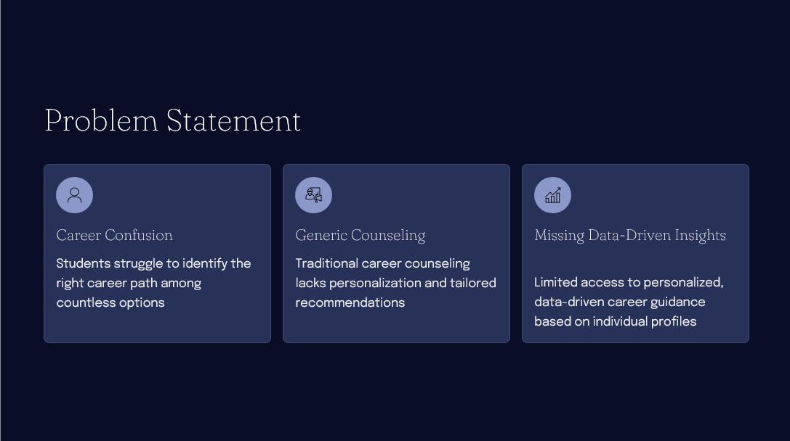

Slide 3
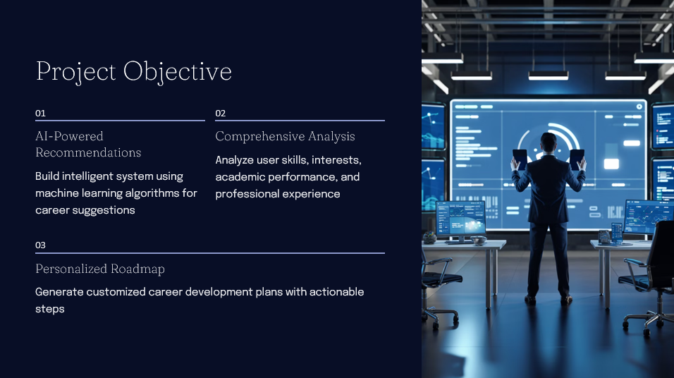

Slide 4
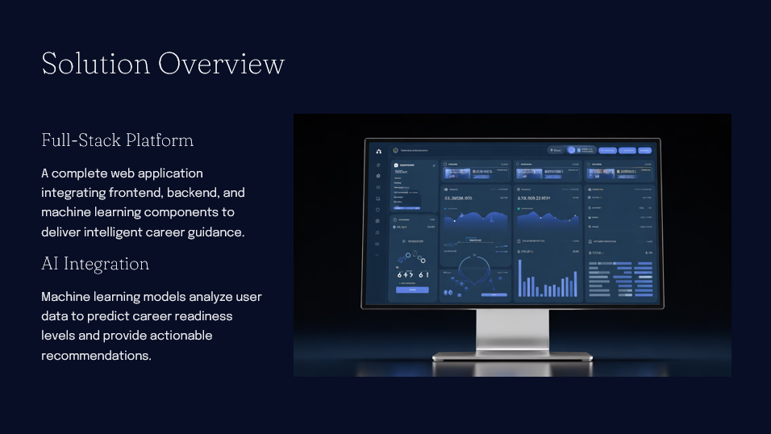

Slide 5
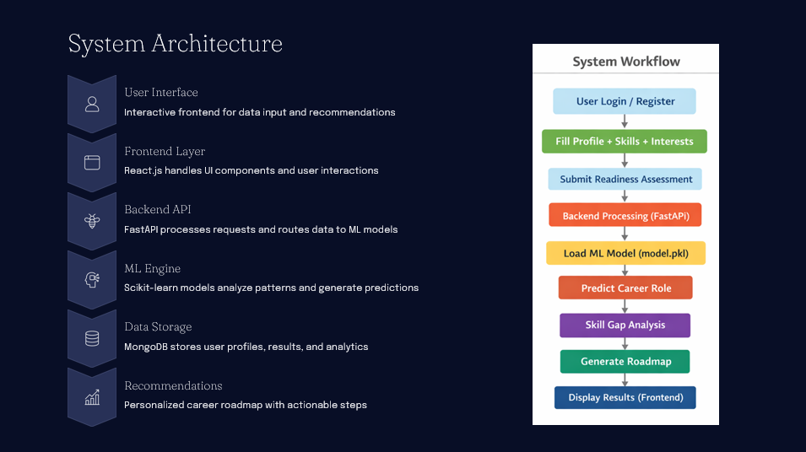

Slide 6
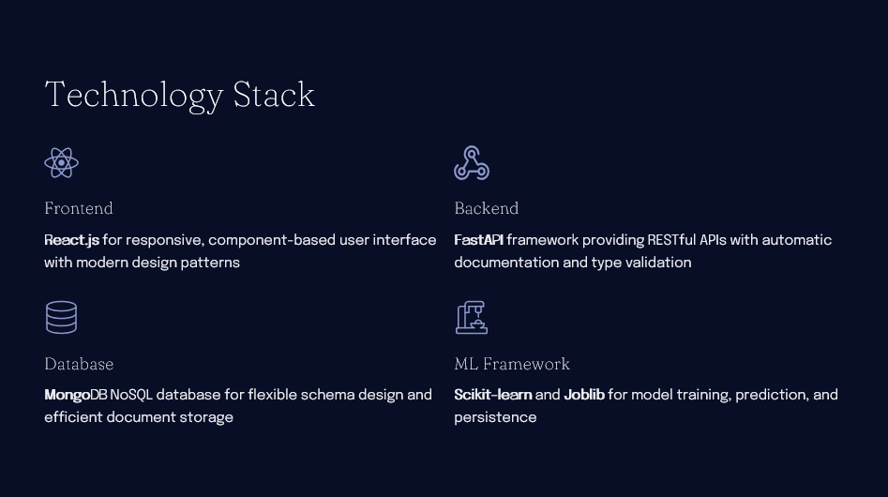

Slide 7
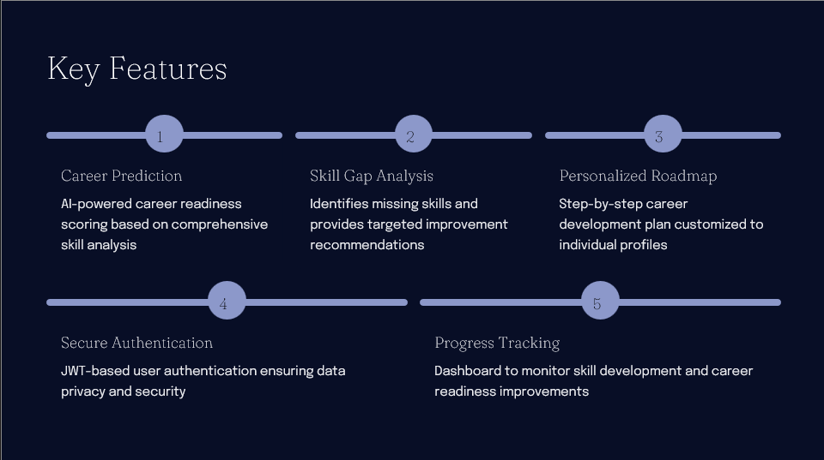

Slide 8


Slide 9
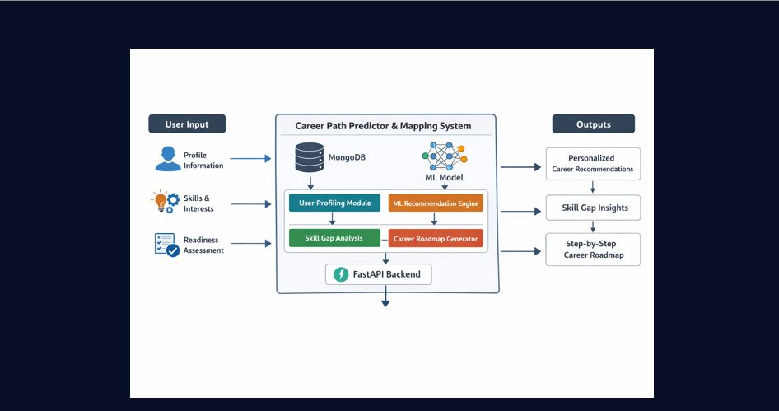

Slide 10
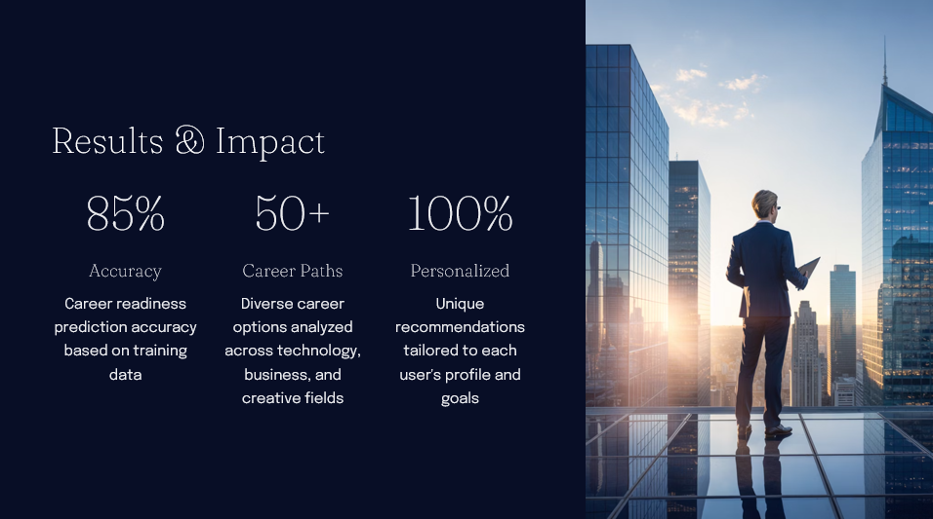

Slide 11
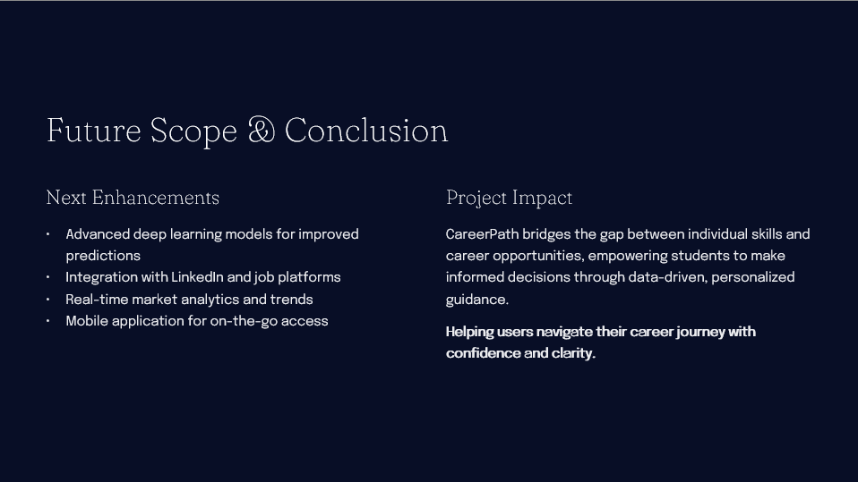

Slide 12
Thank You
12

